Slide 1

yarnnn
Autonomous agents that know your work.
They connect to your platforms. They accumulate knowledge. They work while you don't.
(Pre) Seed Round 2026
Kevin Kim · kvkthecreator@gmail.com

Slide 2
It looks like the big players will own everything.
Claude has coding agents, desktop, cowork.
ChatGPT has memory, Codex, Sora.
The market assumes they’ll consume every layer.
But every platform cycle looks that way — until it doesn’t.
Google didn’t become Salesforce.
Facebook didn’t become Shopify.
AWS didn’t become Datadog.

Slide 3
The Honest Bet
History never repeats, but it does rhyme.
Our thesis is that even with the AI tech revolution, the application layer is yet to come.
2008: Google
→ Looked like it would own everything on the web. It didn’t become Salesforce.
2012: Facebook
→ Looked like it would own all of social commerce. It didn’t become Shopify.
2015: AWS
→ Looked like it would own every cloud application. It didn’t become Datadog.
2026: LLMs
→ Look like they’ll own every layer. But code was the easy case. Work context is the hard one.
The application layer of the AI platform shift is yet to come, and we’re taking the bold bet that it will be Agent-native, and the work economy will shift from human -> agents

Slide 4
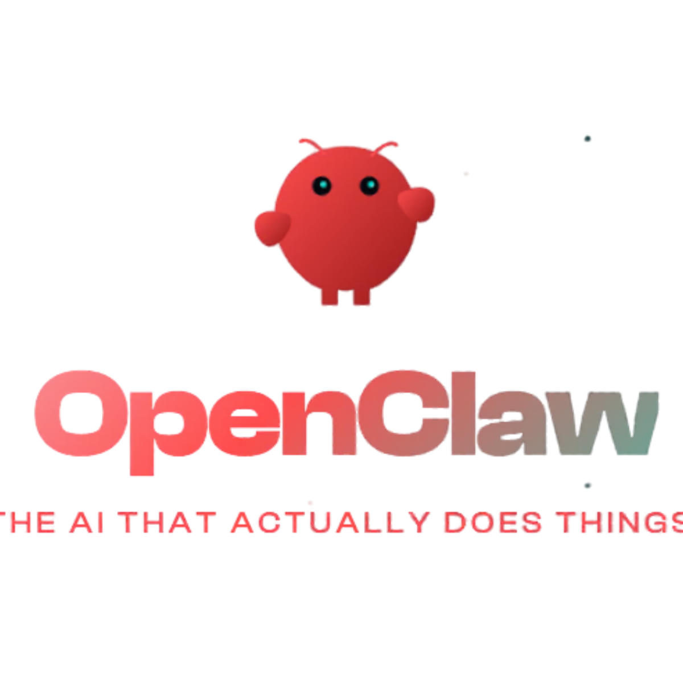
Proof of Demand
ClawdBot proved the appetite is real.
17,830
But 95% of people can't use it.
GitHub stars in 24 hours
High technical barrier, privacy, hardware setup
Fastest single-day growth in GitHub history.
"The first time I've felt like I'm living in the future since ChatGPT launched."
✘ Requires VPS provisioning (only 5% can do this)
✘ 200+ security leaks detected (GitGuardian)
— ClawdBot user
✘ No project isolation or recurring workflows

Slide 5
Product
Architecture
Solution / Moat

Slide 6
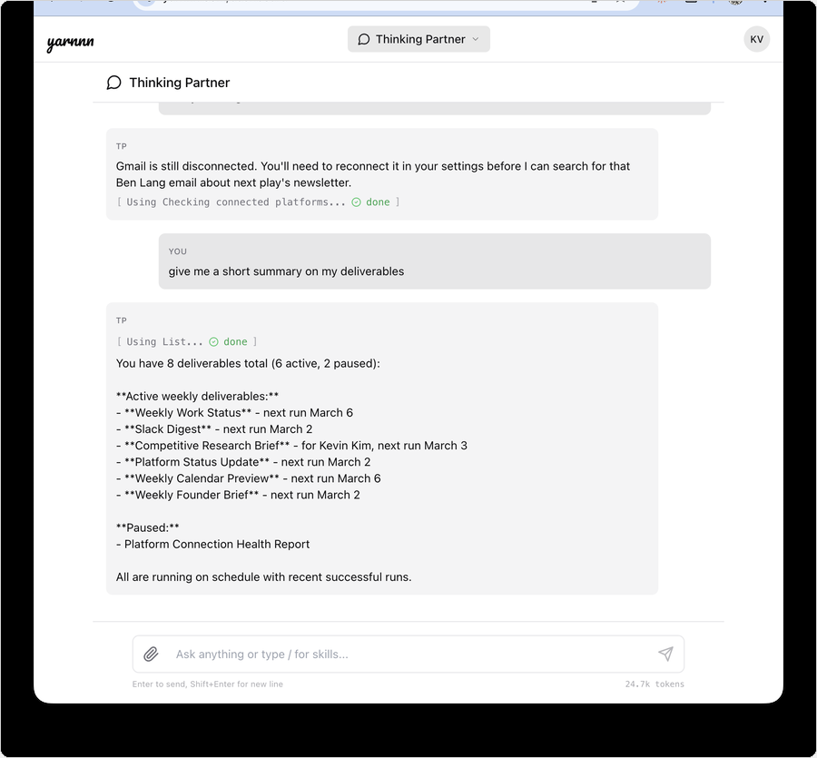
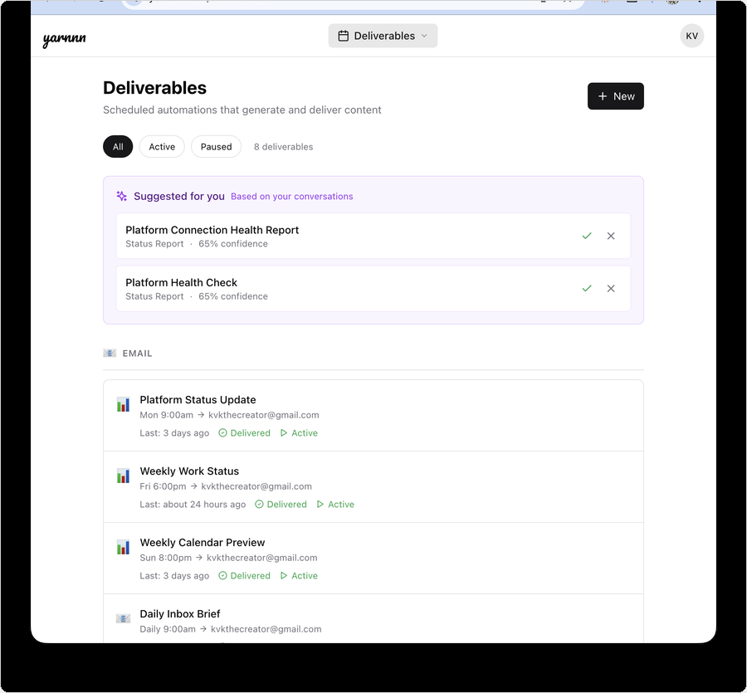
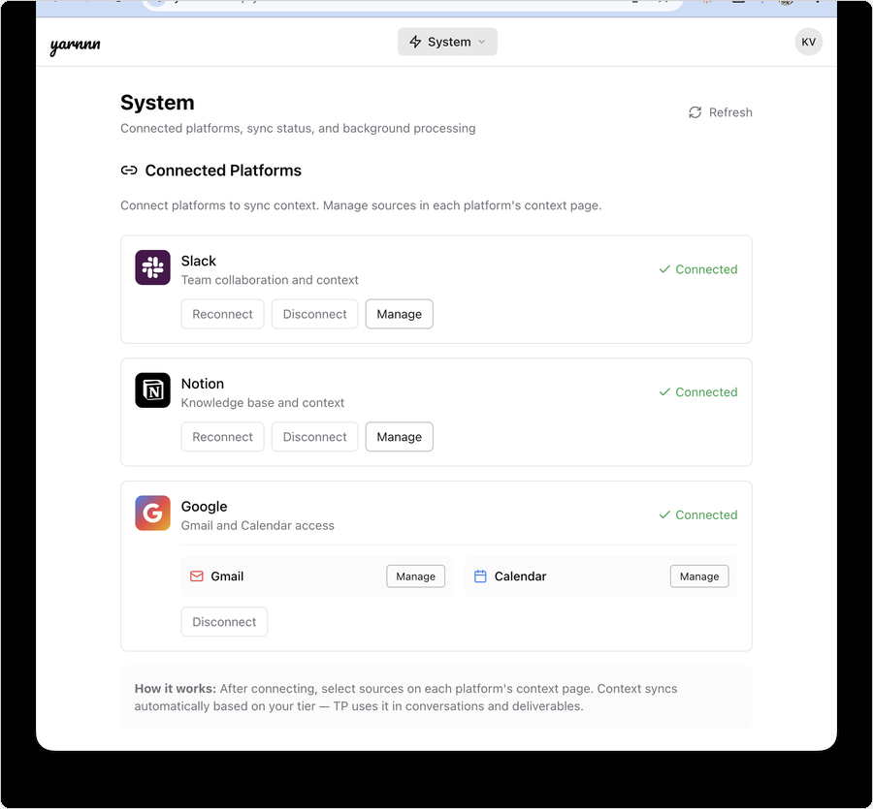
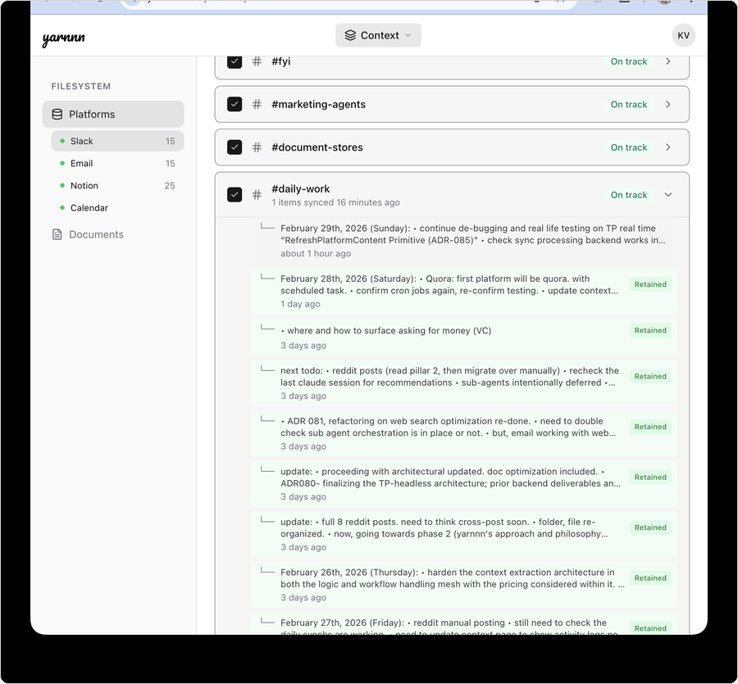
Product: Meet yarnnn's Orchestrator
Your autonomous agent network. Live at yarnnn.com.
T+0s
Connect
T+60s
Auto-Bootstrap
Days
Accumulate
Weeks
Compose
Link Slack, Gmail, Notion, Calendar. Smart defaults. No configuration required.
First agent created automatically. First output delivered within minutes.
Every sync deepens knowledge.
Every edit refines quality.
System identifies new agents
from your accumulated substrate.

Slide 7
Agent Architecture and Orchestration
Built for Agent-native, autonomous workflows
Every layer purpose-built so knowledge compounds — creating recursive feedback between agent output and intelligence
Perception Pipeline
Slack • Gmail Notion • Calendar
Knowledge Base
Unified content Retention + provenance
Memory
Workspace + feedback Edit distillation
Agent Engine
5 execution modes Chat + headless
Agents
Rich output via skills PPTX · PDF · XLSX
→
→
→
→
Connect → Perceive → Bootstrap → First Value → Accumulate → Compose → Compound ↻
Why this can’t be bolted on:
Big Players, LLM Providers
Agent Startups
Workspace AI
No value chain from connection to compounding.
Each session isolated. No agent-to-agent feedback loop.
Can execute but can’t accumulate.
No Phases 5-7 (compounding).
Every run starts fresh.
Trapped in one platform. Can’t compose cross-platform agents.
No recursive perception.
Every layer purpose-built for knowledge accumulation, true autonomy + intelligence

Slide 8
Product
How Your Agent Network Grows
You don’t configure agents. The system grows them from your work — each layer builds on the last.
L1: PLATFORM DIGESTS
L2: SYNTHESIS AGENTS
L3: INTELLIGENCE AGENTS
Auto-Created on Connect
Composer-Created
Compound Insights
You connected Slack. 60 seconds later, a Recap Agent ran. Gmail gets a Digest. Calendar gets a Brief. Zero configuration.
The system notices your L1 digests overlap. It creates a cross-platform agent automatically — no prompt from you.
L1 and L2 agents feed a growing knowledge base. L3 agents surface insights no single platform could produce alone.
T+60 SECONDS:
WEEK 2:
MONTH 2:
“Here’s everything from #engineering, your inbox, and 3 Notion updates.” Runs every morning. Improves with every correction.
Composer detects your recurring 1:1 pattern. Creates a Meeting Prep Agent that pulls attendee context from Slack + Gmail + Notion before every meeting.
“Competitor X was mentioned in 3 Slack channels, 2 client emails, and a Notion brief this week. Here’s a pattern summary.” No human asked for this.

Slide 9
Product
Week 1 vs. Week 12
Same agent. Same workflow. Radically different output quality — because knowledge compounds.
WEEK 1
Generic digest. All channels weighted equally. Standard formatting. You correct tone and trim noise.
What the agent knows:
Platform structure. Channel names. Message content. Nothing about you.
WEEK 4
Knows which channels matter to you. Learned your preferred format from edits. Skips noise. Rare corrections.
What the agent knows:
Your priorities. Your edit patterns. Which sources you act on vs. ignore.
WEEK 12
Zero corrections needed. Anticipates your priorities before you state them. Cross-references patterns across platforms.
What the agent knows:
Your work graph. Cross-platform relationships. Historical patterns. What matters and why.
This is the gap a competitor can’t close. Starting over means starting from Week 1.

Slide 10
Solution: Moat
Knowledge Compounds. Switching Costs Follow.
Every agent run makes the next one better. Every edit teaches the system. Every sync deepens the knowledge base.
Platforms (Slack, Gmail, Notion, Cal)
Connect
Accumulate
Automate
Supervise
Three moat mechanics:
1
Accumulation: Every sync cycle deepens cross-platform understanding. Agents don’t start from zero.
2
Recursion: Your edits and feedback train agent output quality. The 5th run needs fewer corrections than the 1st.
Compounding Work Intelligence
3
Irreversibility: 90 days of accumulated knowledge can’t be exported or replicated. Switching means starting over.
Edits, refine
memory
Knowledge syncs
Autonomous Agent System

Slide 11
Positioning • Market •
Competitive Landscape

Slide 12
Positioning
Not another chatbot. Not another agent framework.
The only platform where persistent agents accumulate cross-platform work knowledge for autonomous output.
Autonomy
yarnnn
Big-Players
ChatGPT/Claude
Agent Startups
Mem.ai, Genspark
Workspaces Notion, Slack
Cross-platform knowledge accumulation
✓ Evolving
✘
✘
Single
ChatGPT
yarnnn
Claude Cowork / Genspark
Cross-platform sync
✓
✘
✘
✘
Knowledge
Accumulation
Autonomous output
✓ Scheduled
✘
✓
✘
Improves with tenure
✓ Accumulation
Evolving
✘
✘
Existing
Workspaces
Agent-based
Startups
Context-aware agent
✓
Evolving
✘
Basic

Slide 13
Market
Starting with solo consultants. Expanding from there.
Entry wedge: Solo consultants with recurring client obligations
TAM
SAM
Entry SOM
$4.35B
$1.14B
$4.6M
AI productivity tools market (31% CAGR)
~5M solo consultants globally × $228/yr (Pro annual)
20K consultants in first 3 years
Expansion path:
Now
Solo consultants
Recurring reports, clear pain, willing to pay
Next
Founders & executives
Investor updates, board prep, strategic briefs
Then
Teams & ops leads
Standups, project reports, cross-team synthesis
Scale
All knowledge workers
Any professional with recurring work obligations

Slide 14
Pricing Model
Two tiers. Knowledge depth is the lever.
Free
Pro
Enterprise
$0
/mo
$19
/mo
TBD
/mo
• 2 platforms connected
• 4 platforms connected
• Everything in Pro
• 5 sources per platform
• Unlimited sources
• Team workspaces
• Sync 2x/day
• Hourly sync
• Priority support
• 50 orchestrator messages/mo
• Unlimited orchestrator messages
• Custom integrations
• 2 active agents
• Unlimited agents
• Agent-to-agent protocol
Unit economics: Target 70%+ gross margin at scale. Batched sync and cached knowledge reduce per-user API cost as context accumulates.
Yearly plan: 2 months free (17% off). Pro $190/yr.

Slide 15
Product Roadmap
Autonomous Agent Network (shipped) → Cross-Platform Intelligence → Agent Protocol
Each phase deepens the value chain. Shipped work compounds into the next layer of capability.
SHIPPED ✓
NEXT 6-12mo.
VISION +12mo.
Autonomous Agent Network
Cross-Platform Intelligence
Agent-to-Agent Protocol
Auto-bootstrap + Composer agents. 4 platform integrations.
Output gateway: agents produce PPTX, PDF, XLSX, charts.
Feedback substrate: edit distillation + agent self-reflection.
Workspace filesystem + cross-agent collaboration.
Projects: multi-agent assembled deliverables (decks, reports, briefs).
Composer-driven assembly from agent contributions.
Deeper platform coverage: 365, Google Drive, Social.
MCP protocol interop. External agents consume YARNNN context.
Agent-to-agent coordination across systems.
Platform play: own the work context graph.

Slide 16
(Pre) Seed - The Ask
$500K at $5M post-money valuation.
Use of funds:
Why now:
Positioning:
→ Tech Lead (memory/ML)
→ ClawdBot: 17,830 stars / 24hrs
→ Application layer sill pre-mature
→ GTM Lead (creator community)
→ No one owns the context layer
→ True Agent-native architecture
→ 12 months runway
→ Architecture built, need team
Priority 0: Team-Building
Betting on an agent-first future:
Differentiation:
→ ML engineer for memory extraction
→ LLM readiness moving towards Agents
→ Cross-platform, LLM agnostic
→ Community builder for creator GTM
→ Thesis is the work economy will shift
→ Big players can’t do cross data accumulations
→ Seed funds → team of 3

Slide 17

yarnnn.com · Kevin Kim · kvkthecreator@gmail.com

Slide 18
Appendix
Kevin Kim
Founder & CEO, KVK Labs (yarnnn)
https://www.linkedin.com/in/kimseulki0727/
B.S. Industrial and Systems Engineering, Virginia Tech
+10 years designing CRM and GTM systems in FMCG.
CMO, CPO positions in Korea based startups, Ran e-commerce fashion brand for 5 years,
Full-stack application for yarnnn, (Next.js + FastAPI + Supabase), four platform integrations, unified agent architecture documented across 115+ Architecture Decision Records.
Targeting US market; execute GTM and team-building as priority next step.
kvkthecreator@gmail.com · yarnnn.com

Slide 19
Appendix: Value Realization Chain
What the User Experiences: Connect to Compound
Connect → Perceive → Bootstrap → First Value → Accumulate → Compose → Compound ↻
Time What happens What the user sees
T+0s OAuth completes, sources auto-selected Dashboard: “Slack connected”
T+60s Bootstrap creates agent, first run executes First agent appears, first output delivered
Day 2-7 Daily syncs accumulate, digest agent runs daily Digests arrive on schedule, improving each run
Week 2 Composer heartbeat assesses substrate Composer suggests or auto-creates cross-platform agent
Month 1 Multiple agents running, user has given feedback Agents noticeably tailored to preferences
Month 3 L2-L3 agents producing insights from digests System understands work at a level no fresh start replicates
Each phase’s output is the next phase’s input. A competitor starting from zero cannot replicate a tenured YARNNN instance.

Slide 20
Appendix: Architecture Depth
What a Well-Funded Team Can’t Shortcut
Each layer assumes the ones below it exist. 122 Architecture Decision Records document each tradeoff.
“Claude Code Online” — Output Gateway
Autonomous Orchestration — Composer Heartbeat
Same capabilities model as Claude Code (SKILL.md + local tools + filesystem), but persistent, autonomous, and cloud-native. Two-filesystem architecture: capability filesystem (skills on Docker) + content filesystem (workspace per agent). Adding a new output format = adding a skill folder.
A cron-triggered heartbeat assesses the entire agent workforce: substrate signals, content freshness, agent maturity, cross-agent patterns. Creates agents, pauses underperformers, dissolves unused ones, coaches via supervisor notes. No human in the loop.
Feedback-to-Intelligence Loop
Multi-Agent Project Coordination
Three unified feedback rails: user edits distilled to persistent preferences, agent self-reflection after every run, Composer lifecycle coaching. Agents progress through seniority levels (new → associate → senior) with expanding duty portfolios. “Improves with tenure” is structural, not aspirational.
PM agents coordinate contributor agents toward assembled deliverables. Contribution briefs steer agent focus. Quality assessment gates assembly. Work budget governors bound autonomous compute. Intent decomposition translates user goals into bounded, executable work plans.
Why this compounds into defensibility:
The Composer heartbeat can’t work without the feedback substrate. The feedback substrate can’t work without the workspace filesystem. The workspace filesystem can’t work without the perception pipeline populating it. Each architectural layer was designed knowing the layers above it would exist. A team starting today would need to discover these interdependencies through the same 122 decisions — or build a simpler system that can’t compound.
Full technical architecture brief available on request.

